Slide 1
Process Mapping in ATCA MGC-8
April 2014

Slide 2
Agenda
Process Mapping Overview
Single Process Overview
SLAM/CLAM Overview
TL1 Related
Inter-Process Comm Overview
Keeps Track of System State
Centralized alarms
State Replication
GR Mgmt
Others

Slide 3
Process Mapping Overview

Slide 4
Process Mapping Overview (Single Process)
How to Build Process:
    E.g.: gu_cli
What Process in AXCM:
    Code View:
    ACCM: TelicaRoot/components/ga_dev/solution/fam/hostApp.xml
    ADCM: TelicaRoot/components/cm_mon/cmApp.xml
    Switch View:
    ACCM: /Telica/swCPU/CurrRel/schema/hostApp.xml
    ADCM: /Telica/swCPU/CurrRel/schema/cmApp.xml
How to Run Process:
    /etc/rc.d/init.d/plexus_init
    |
    |-> /Telica/swCPU/CurrRel/system/scripts/plexus_init.sh
    |
    |-> /Telica/swCPU/CurrRel/emf/startemf (ACCM)
    or |-> /Telica/swCPU/CurrRel/apps/cm_mon/startcm (ADCM)
    |
    |-> “emf/cm_mon starts all the other processes per hostApp.xml/cmApp.xml
Process Priority:
    rt: OalThreadCreate(): /TelicaRoot/components/lynx/usr/include/telica_priorities.h

Slide 5
Process Mapping Overview (Inter-Process)
Comm Mechnism:
    GA
    Relay (sharedMM or TCP)
How to SetUp Comm Channels:
    GA:
    SubscribeEvent()/PublishEvent()
    Relay:
    ry_config()
    chanId: TelicaRoot/components/signaling/sigcom/lry.h
How to Debug Comm Issue:

Slide 6
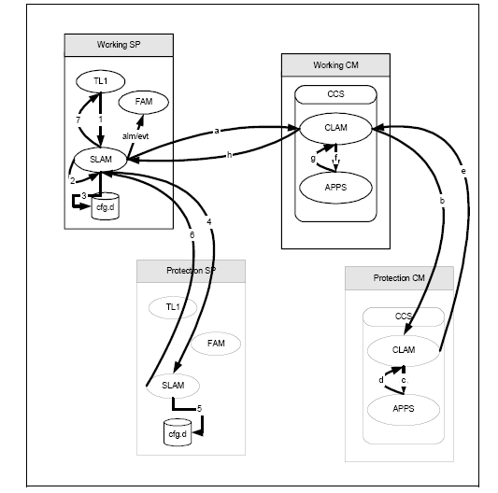
SLAM/CLAM Details – TL1 Related (sl_tl1.c/sl_tl1_fsm3.c)
Notes:
Interface manager between TL1, EMF, CCS, Router, GDI (billing), Database
Validates TL1 requests
Handles multiple TL1 responses at same time
Forwards data to CLAM, Handle multi-session and multi-CCS process configuration commands in parallel

Slide 7
SLAM/CLAM Details – TL1 Related (FSM1)

Slide 8
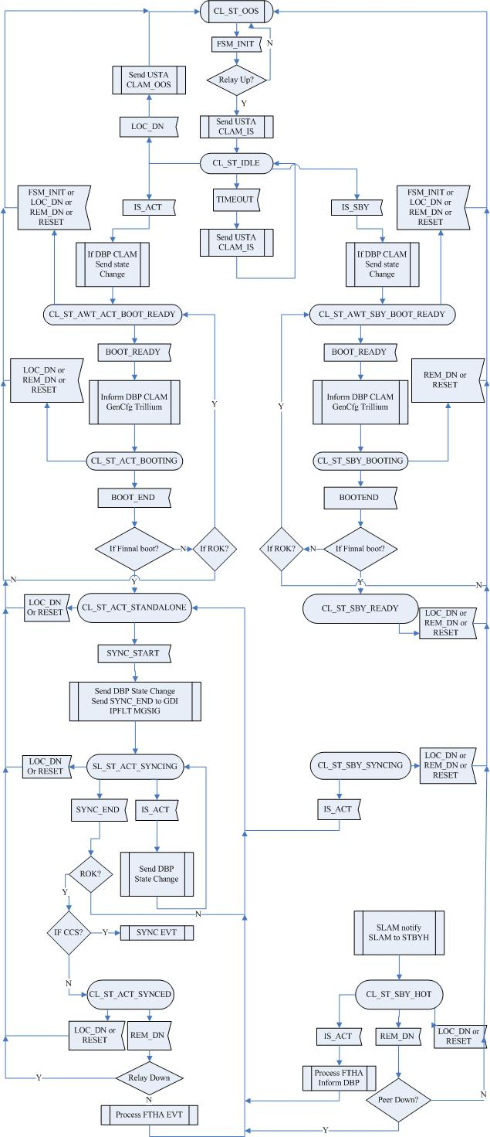
SLAM/CLAM Details - Keeps Track of System State
BRD_FSM(sl_brd.c), SL_CLAM_FSM(sl_clam_fsm.c), CLAM FSM(cl_fsm.c)

Slide 9
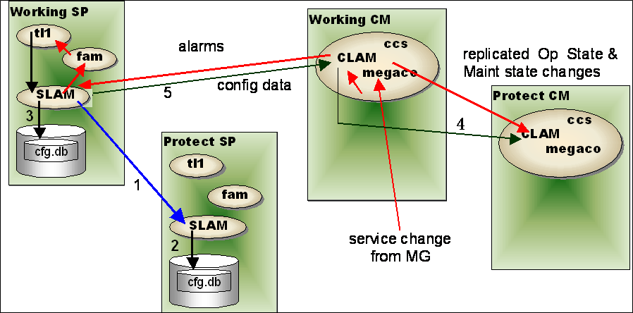
SLAM/CLAM Details - Centralized Alarms
sl_clalm.c/sl_clalm_tb.c/cl_alm.c

Slide 10
SLAM/CLAM Details – State Replication
psf-slam/zsl_xxx.c
cl_rep*.c

Slide 11
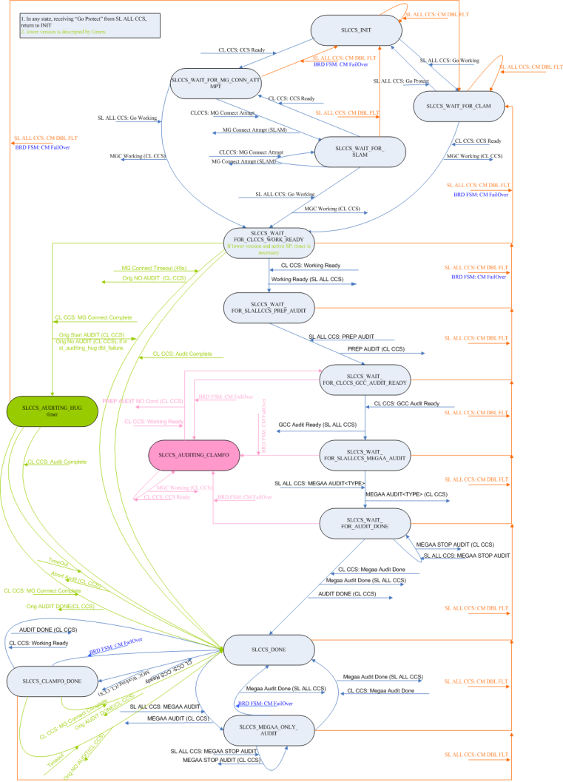
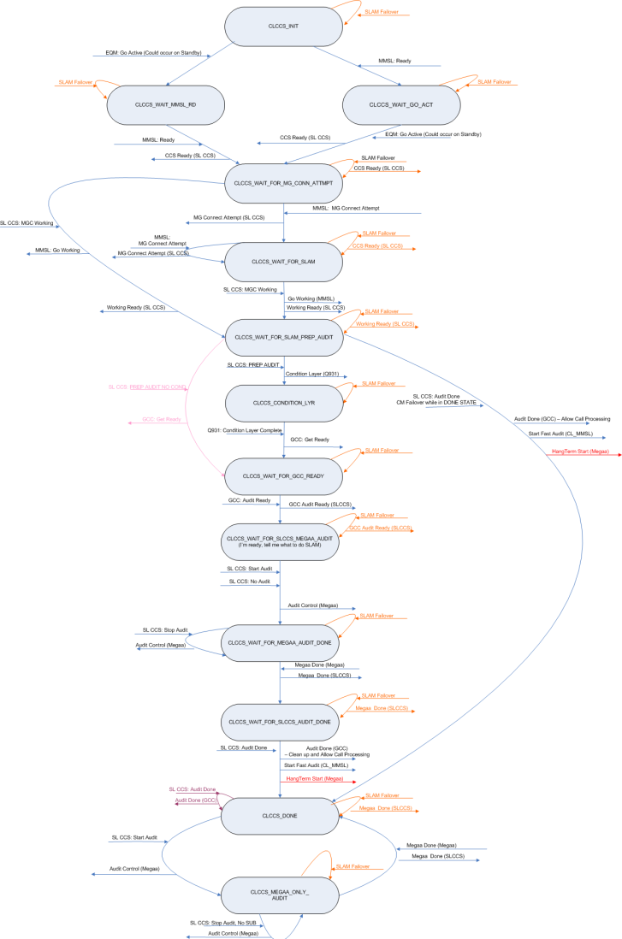
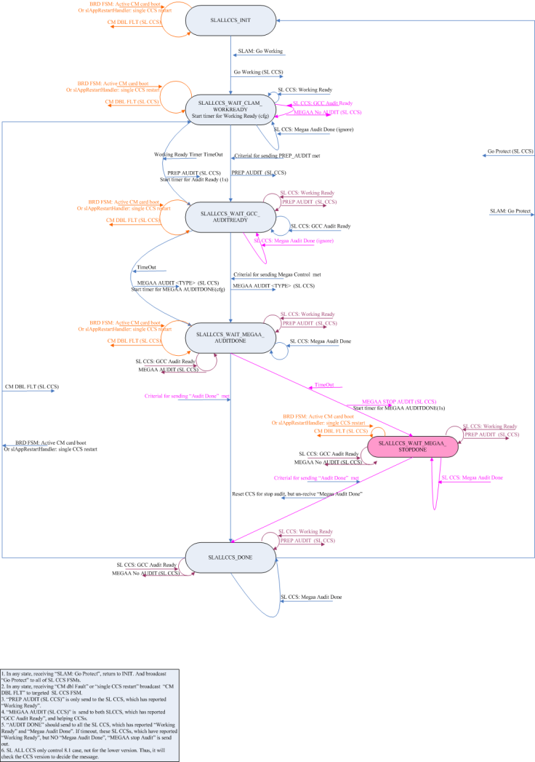
SLAM/CLAM Details – GR Mgmt
sl_georedslam.c/sl_georedslamallccs.c/sl_georedslamccs.c/cl_georedccs1.c/cl_georedccs2.c

Slide 12
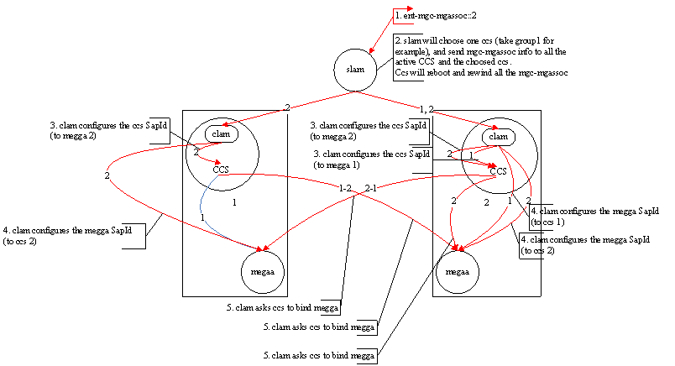
SLAM/CLAM Details – Others
License Management (sl_licaudit_fsm.c)
Bulk Download
Dynamic Bind CCS

